Slide 1

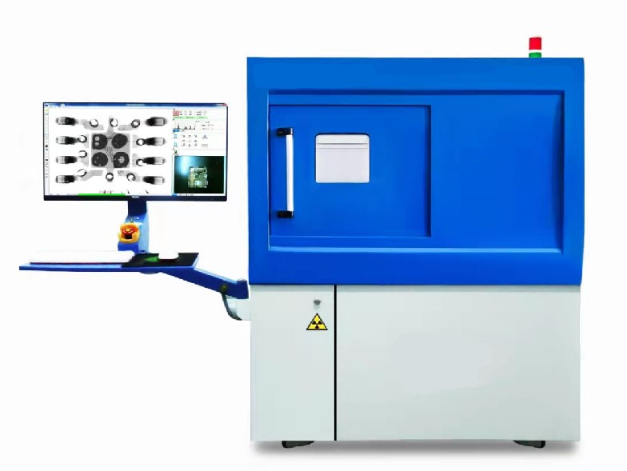

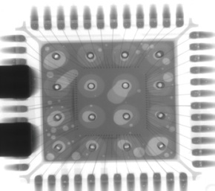
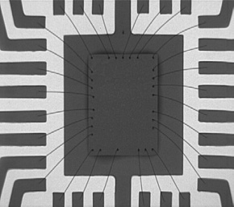
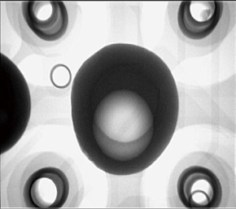
Professional Microfocus X-ray
Inspection System for Electronics
PRODUCT INTRODUCTION
X RAY TECHNOLOGY
X RAY SYSTEMS PROFILE
INTRODUCTION

Slide 2




X RAY SYSTEM APPLICATIONS
APPLICATIONS
SMT/PCBA Inspection
Semiconductor Inspection
Lithium Battery Inspection
LED/Component Inspection

Slide 3
X RAY SYSTEM DESCRIPTION
X RAY INSPECTION
SYSTEM FOR ELECTRONICS
The MK-200A is one of the best and most proven offline X-ray inspection systems on the available market today. This system has received a lot of traction from many industries,which is widely used for electronics,such as LED, SMT, DIP, lithium battery inspection and other electronic components.It covers inspection for IC, BGA, CSP, flip chip and other encapsulation types. In the automobile industry, the MK-200A can be also used in the inspection of small auto parts.
FX-200A

Slide 4
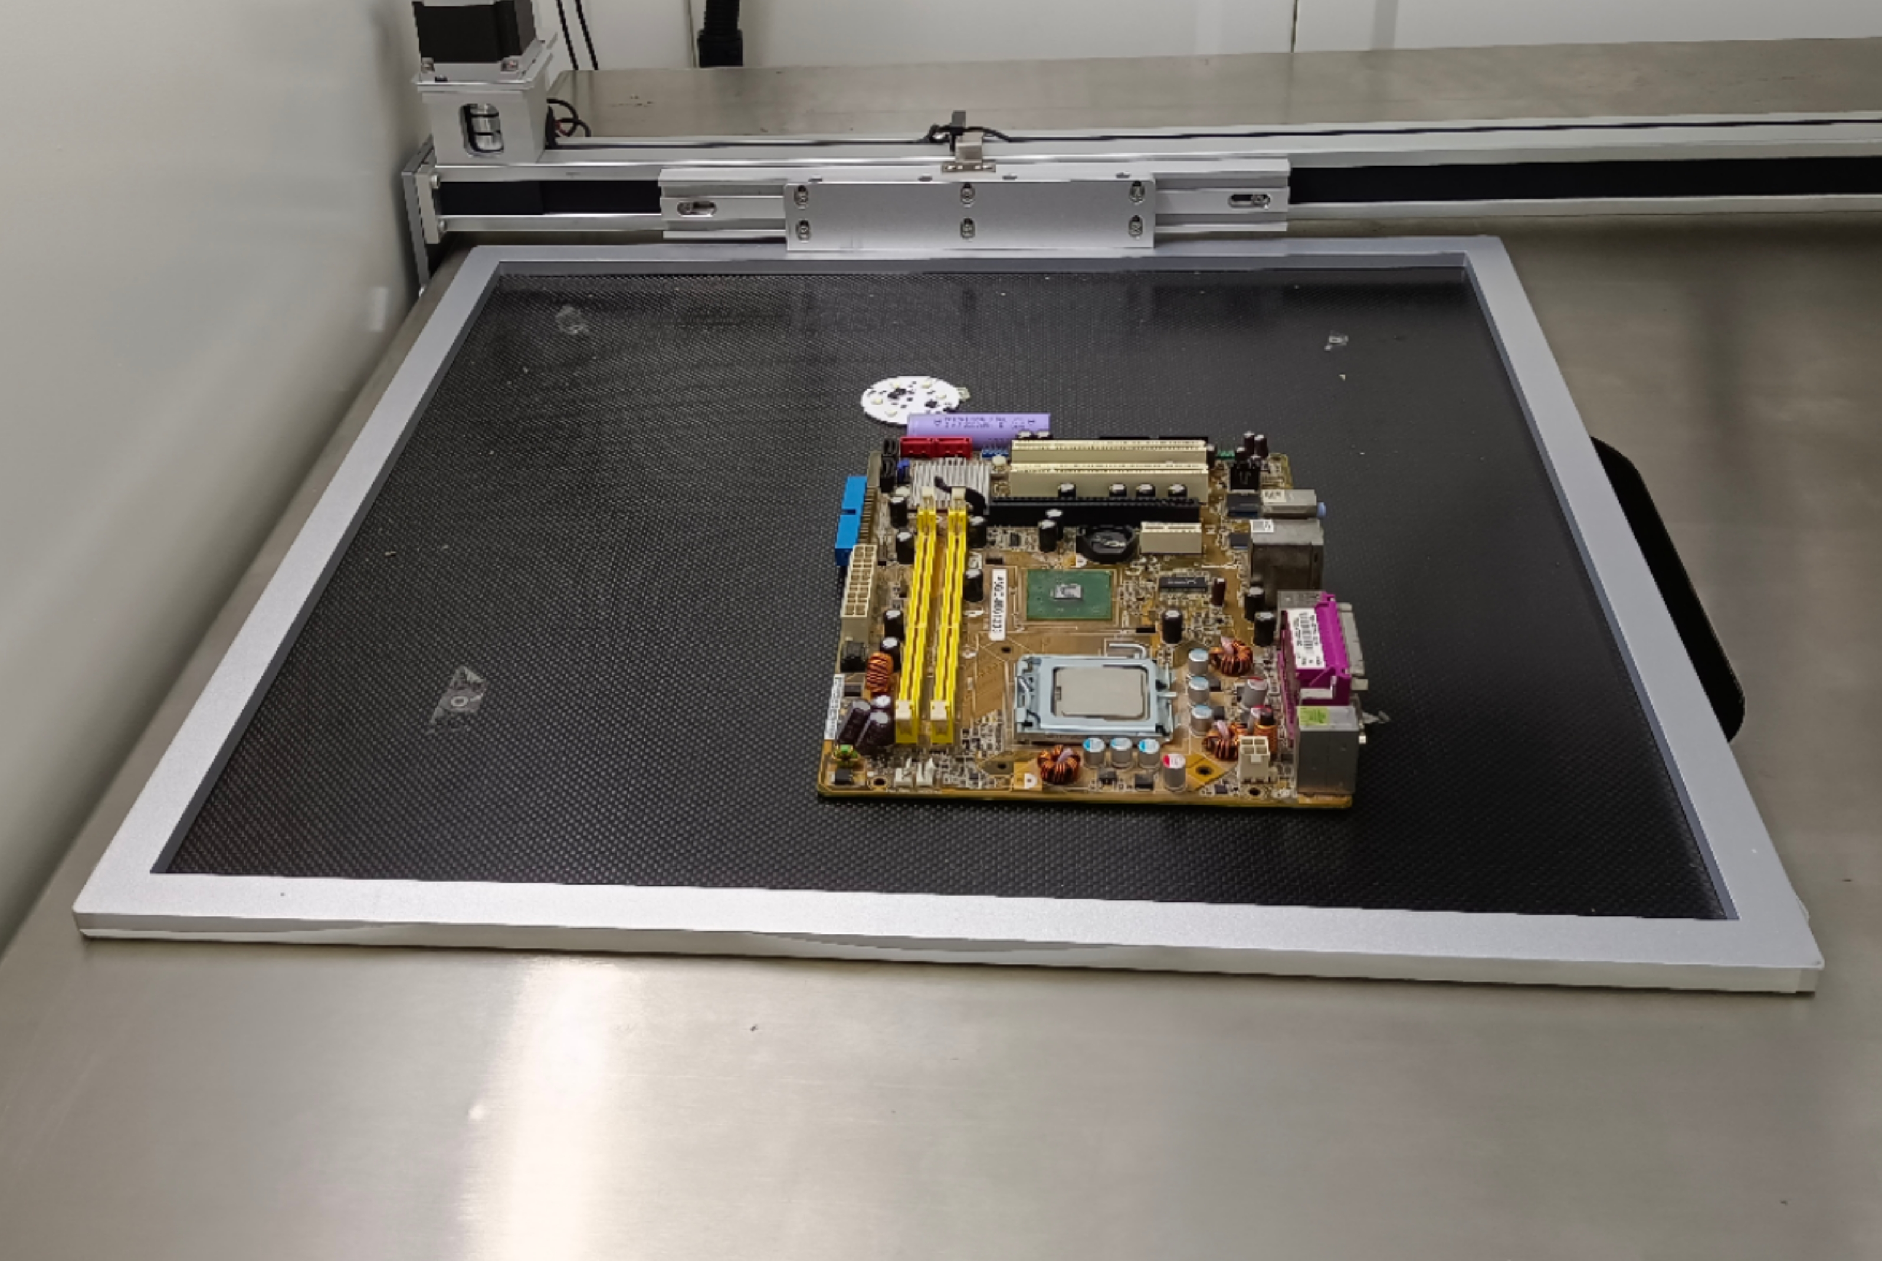
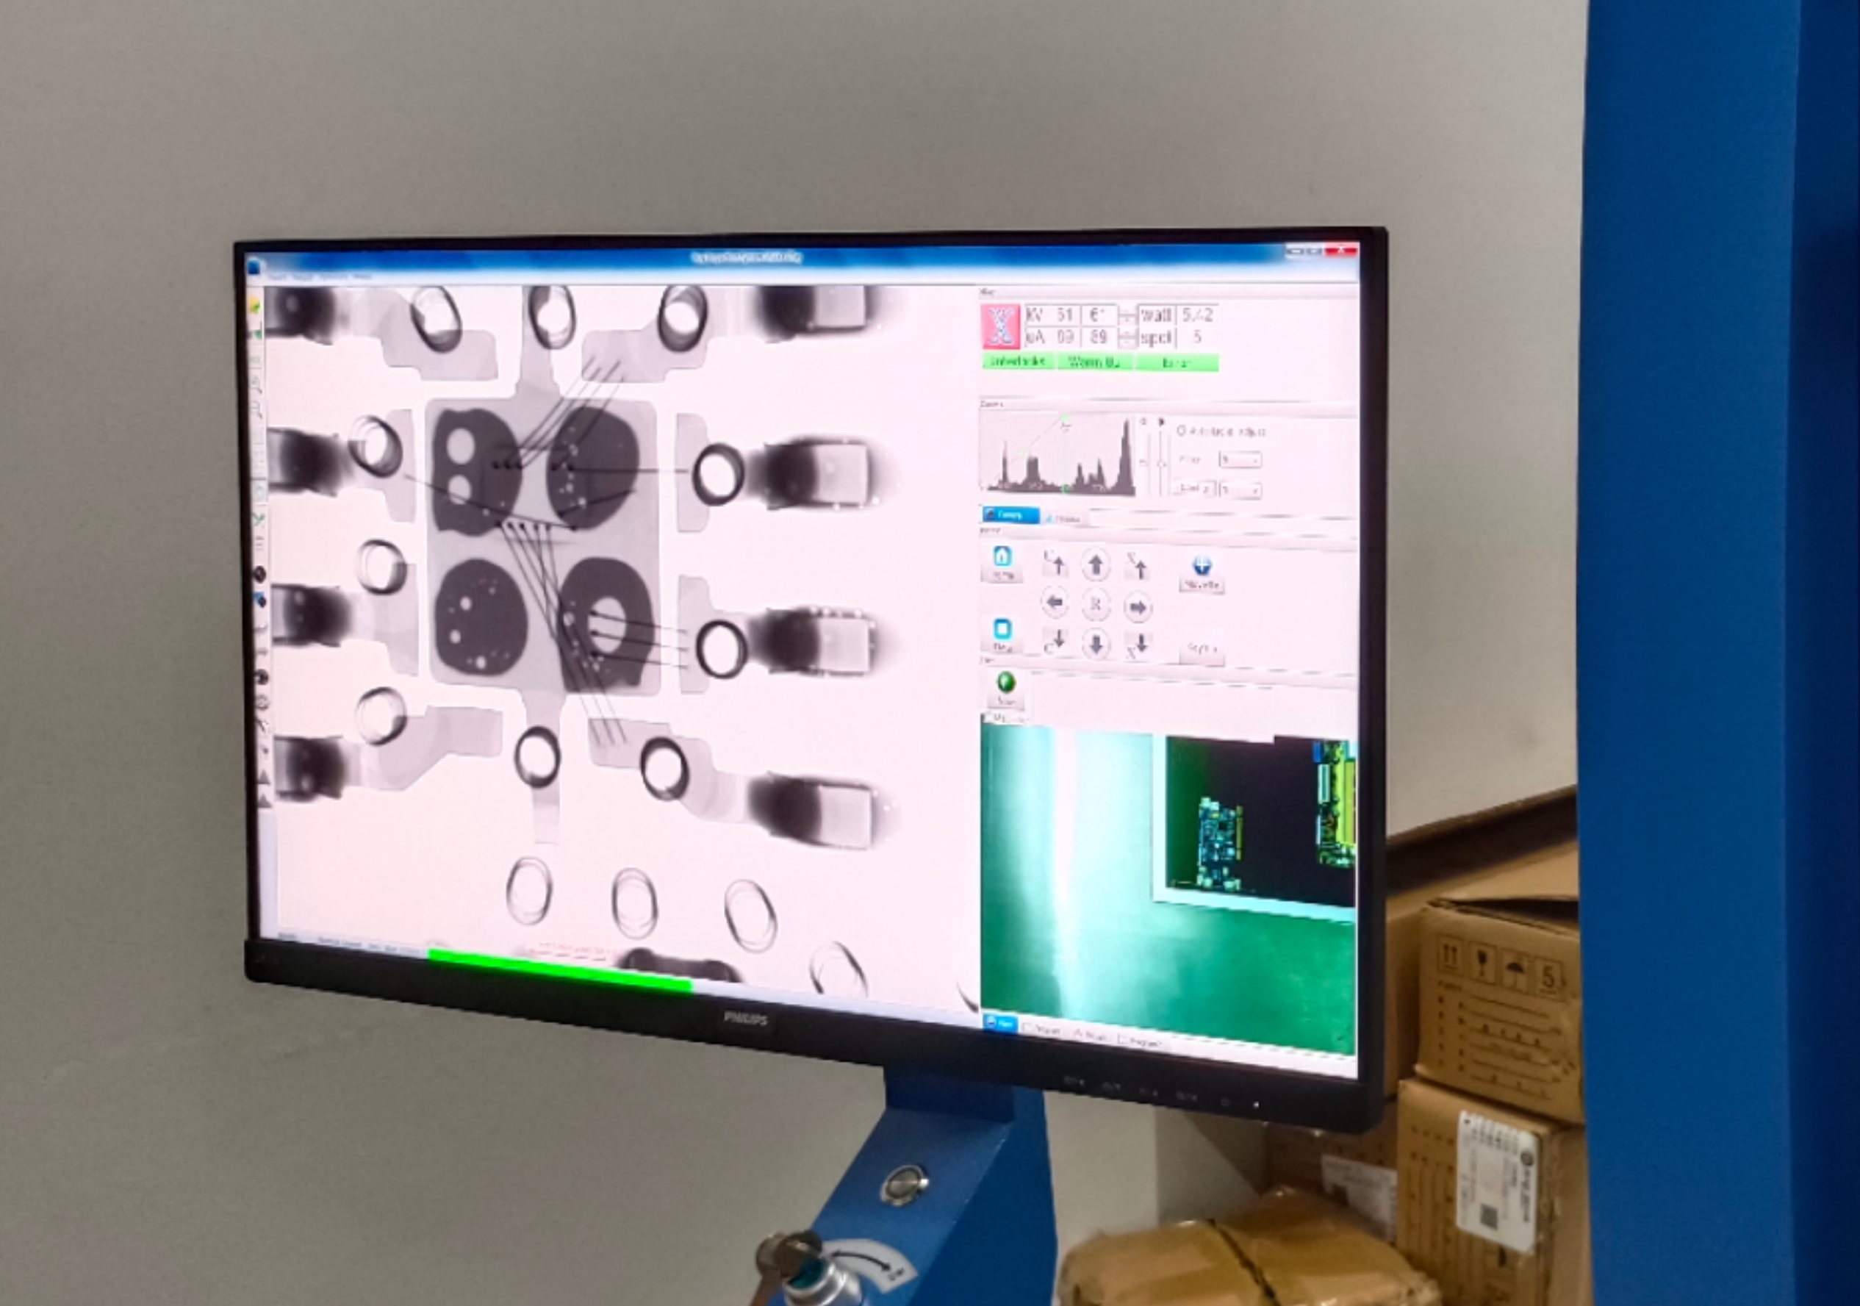
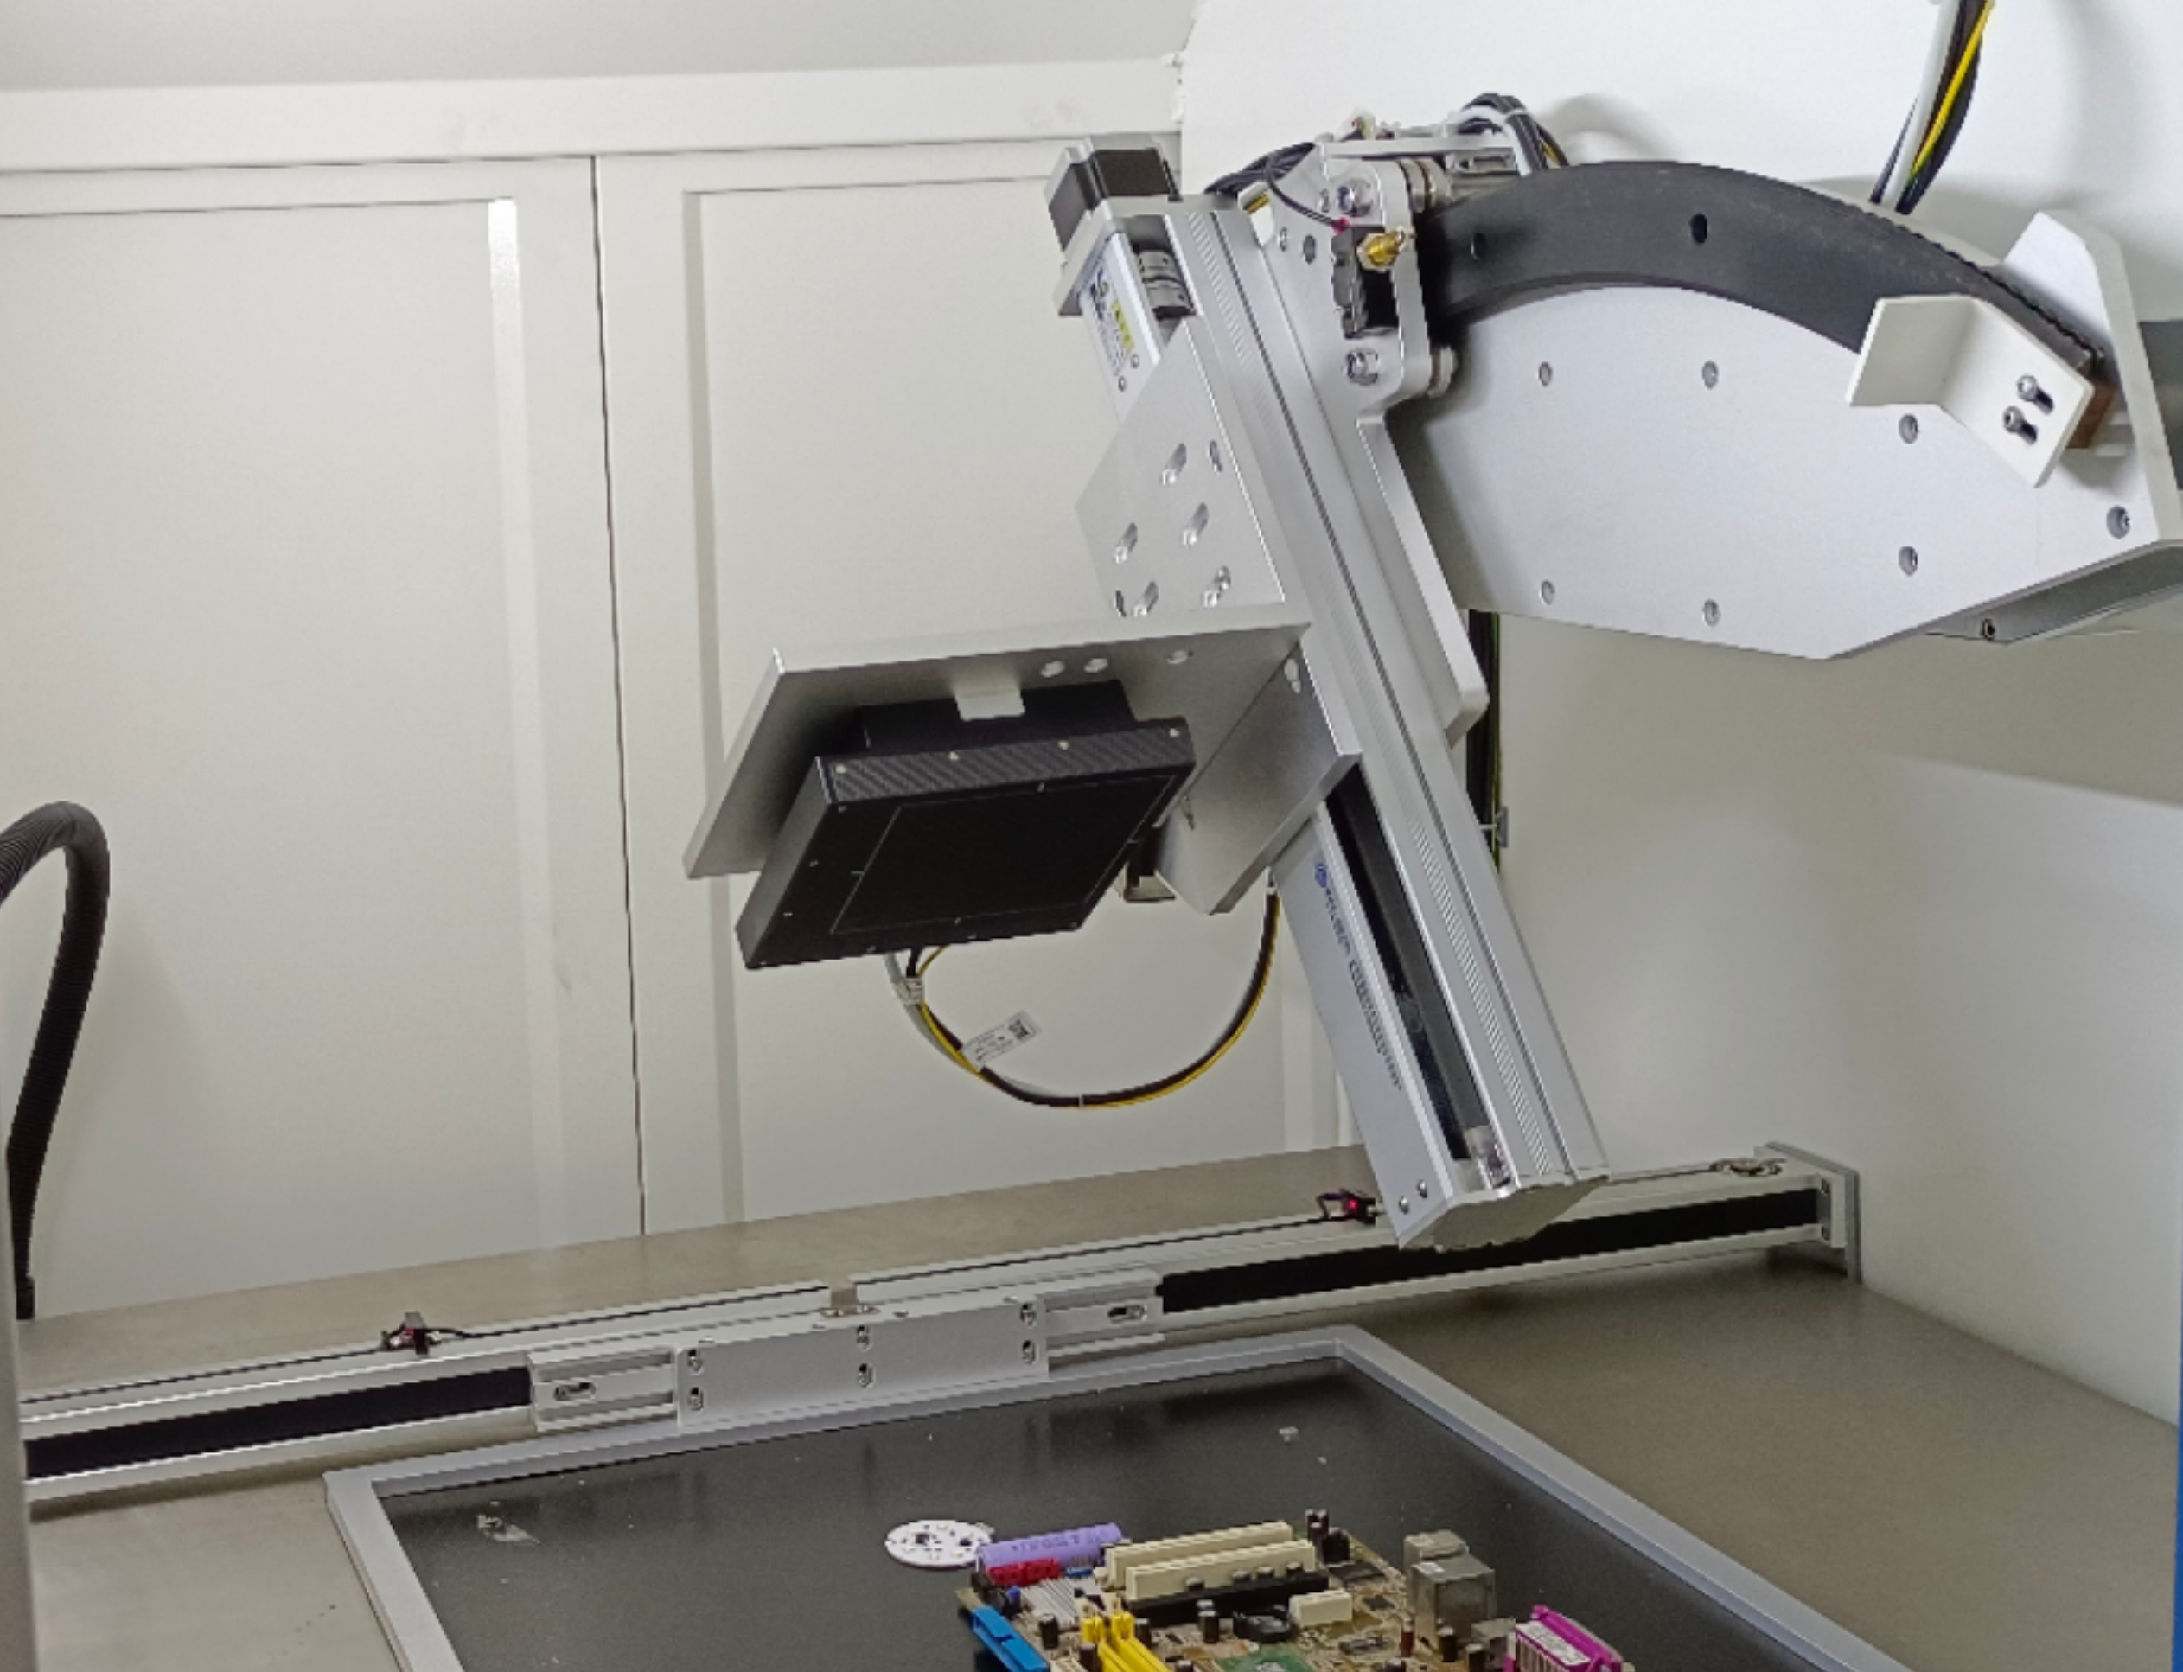
X RAY SYSTEM FEATURE
Main Features
570×570mm inspection area
24 inches
software system
0~65°
detector angle
large size inspection loading platform for mass samples,automatic navigating for precise positioning.
Accurate control,CNC programing,multiple inspection functions,stable performance and fast detection.
flat-panel detector can rotate 0~65d° degree from different angles for determining tinier and underground defects.

Slide 5
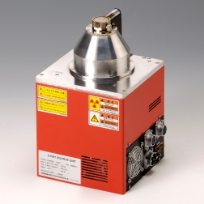
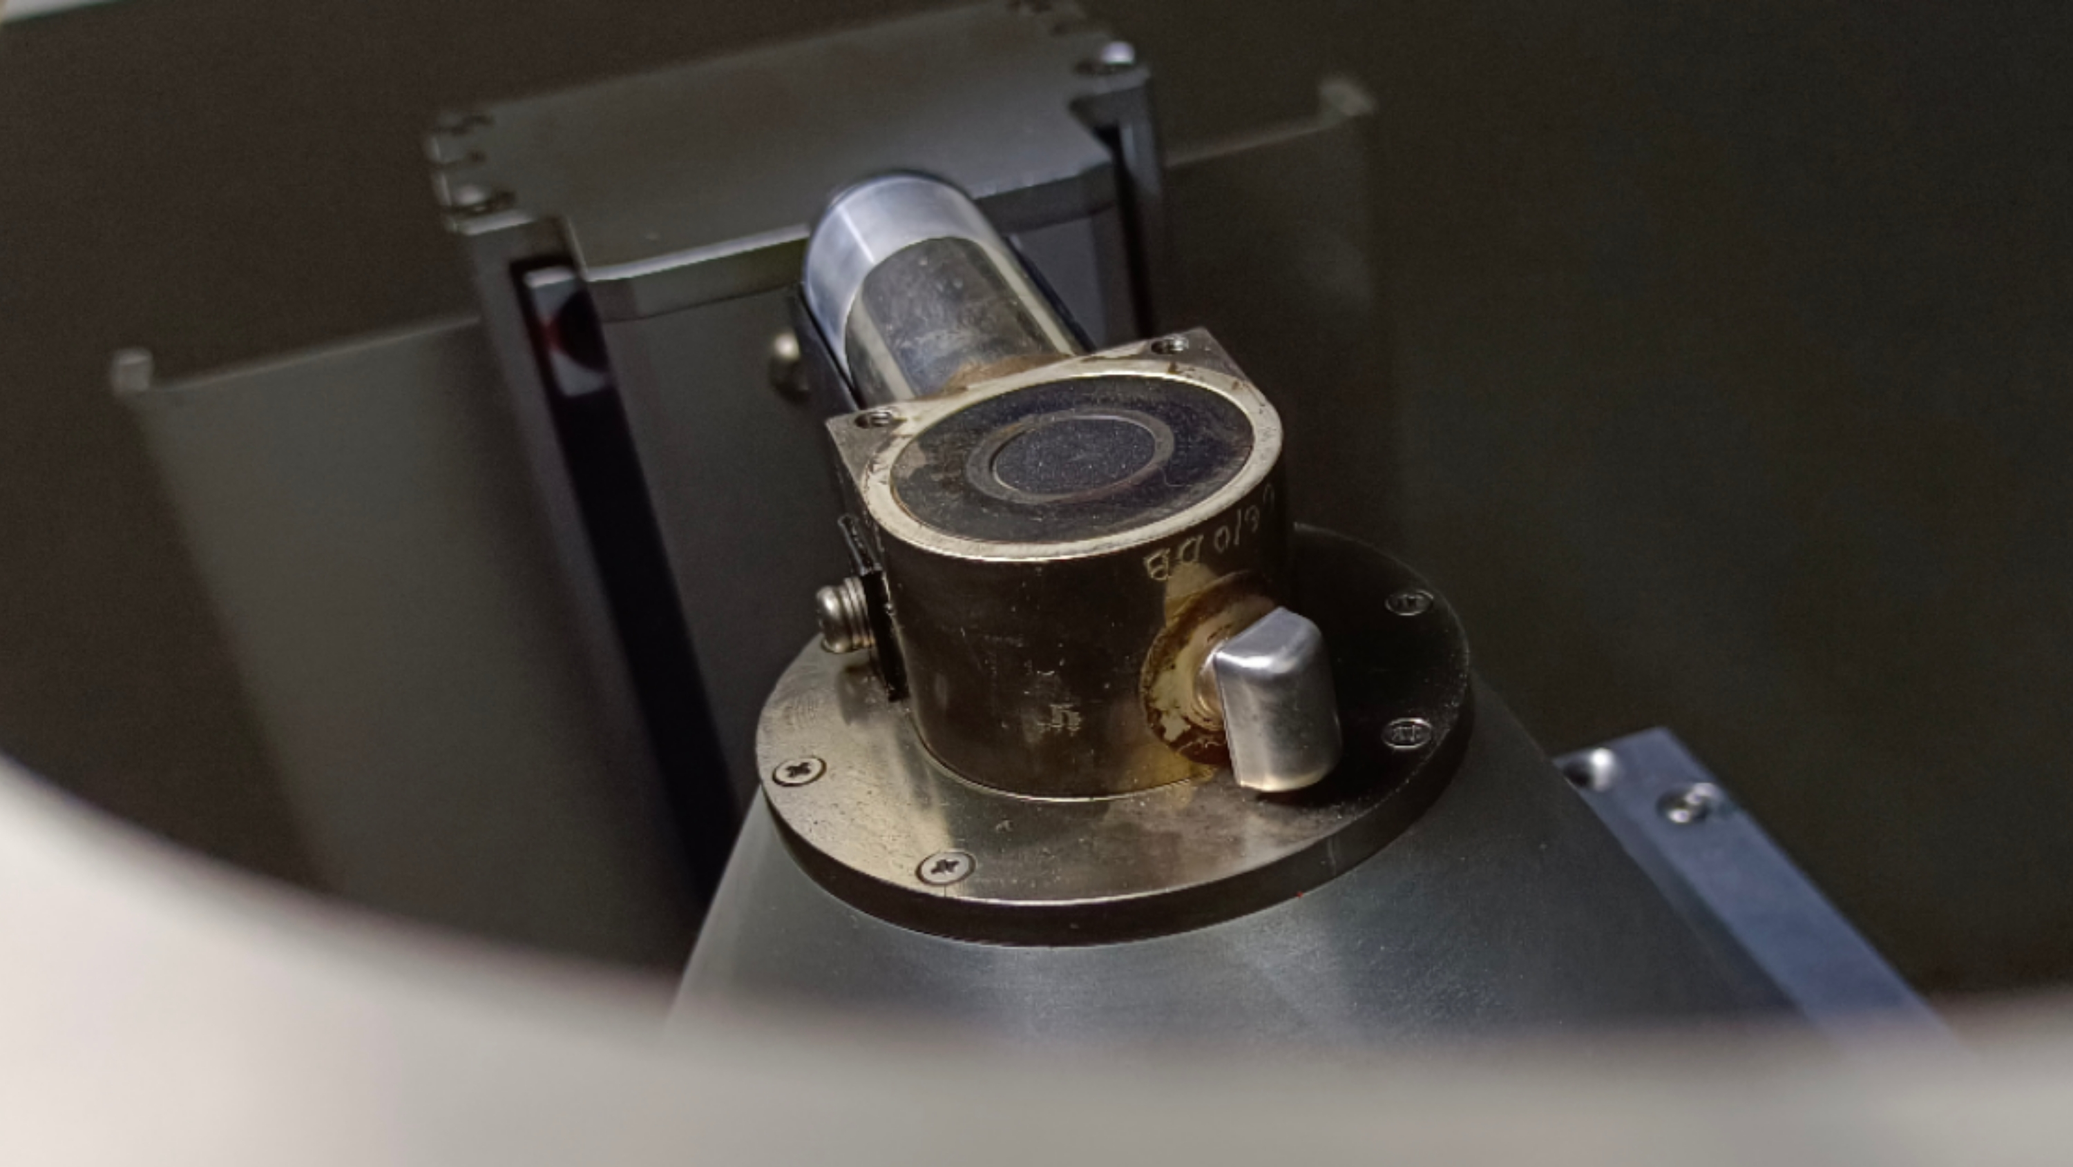
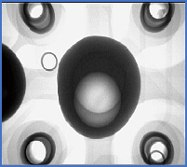
公司介绍
X RAY SYSTEM FEATURE
Main Features
0~90Kv
closed X-ray tube
3~5 μm
micro-focal spot
1600x system magnification
Generally the x ray voltage range 0-90Kv is already enough to penetrate most of semiconductor/electronics materials.
Microfocus technology has higher definition X-ray images and exposure different kind of inner tinny defects.
Large magnification means flexible processing.This X ray system has larger magnification 1600x to ensure images are magnified for tiny defects.

Slide 6
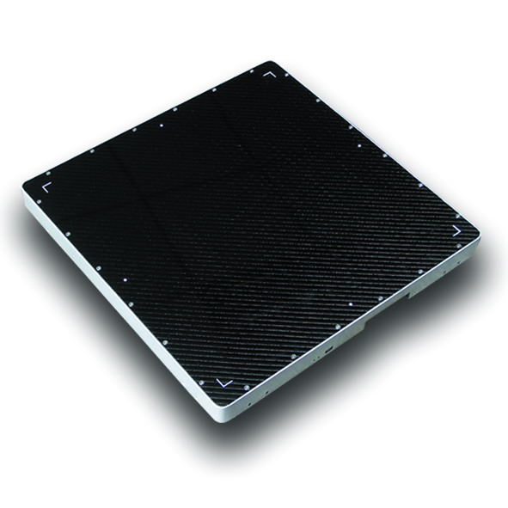
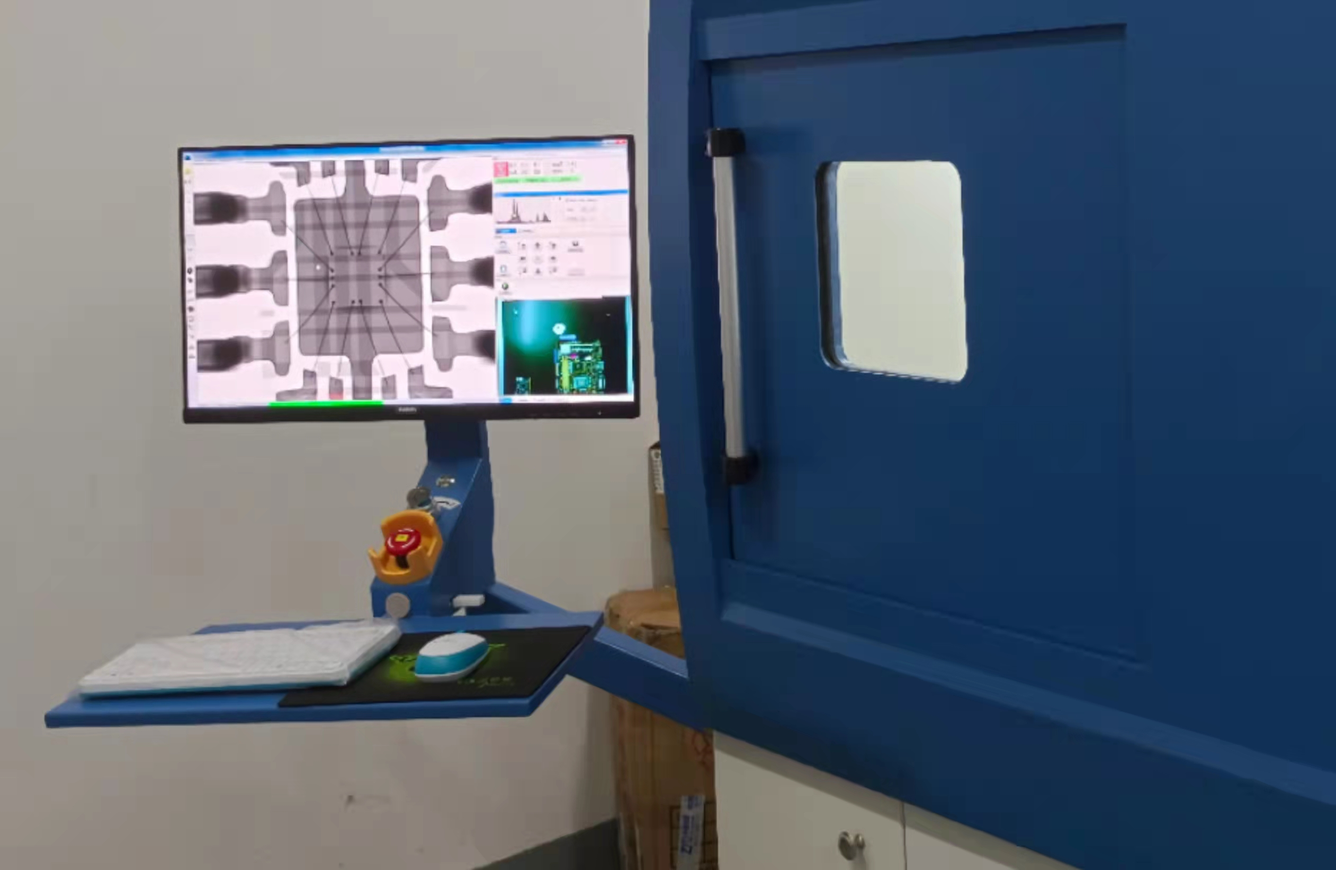
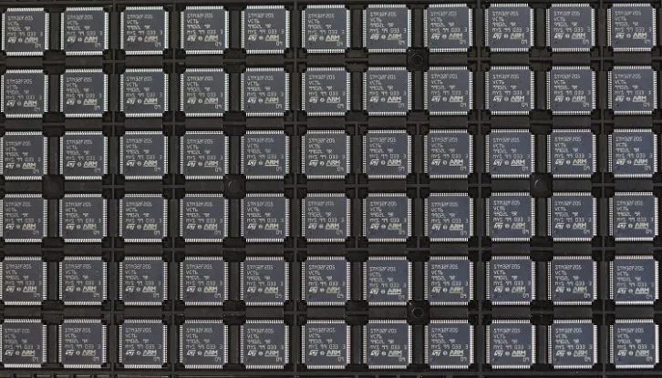
X RAY SYSTEM FEATURE
Main Features
130×130mm
detection area
Electromagnetic
interlock
CNC programing inspection
The software can receive and present a whole X ray image of large physical object with 130×130mm.
Safer mechanical system involves electromagnetic interlock,safe window,warming light,emergency stop,X-ray switch linkage,etc.
This system has larger loading platform to load multiple samples at once to ensure inspection efficiency by CNC programing inspection.

Slide 7

公司介绍
X RAY SYSTEM CORE TECHNOLOGY
Core Part Ⅰ
Closed X-ray source
Our X-ray machine use HAMAMATSU X-Ray tubes.Hamamatsu Group, is the world's leading optical science and optical industry company with the highest level of technology and market share.Our X-ray sources have a lifetime of 12-15 years and are currently the most stable X-ray sources in the industry and the world.

Slide 8
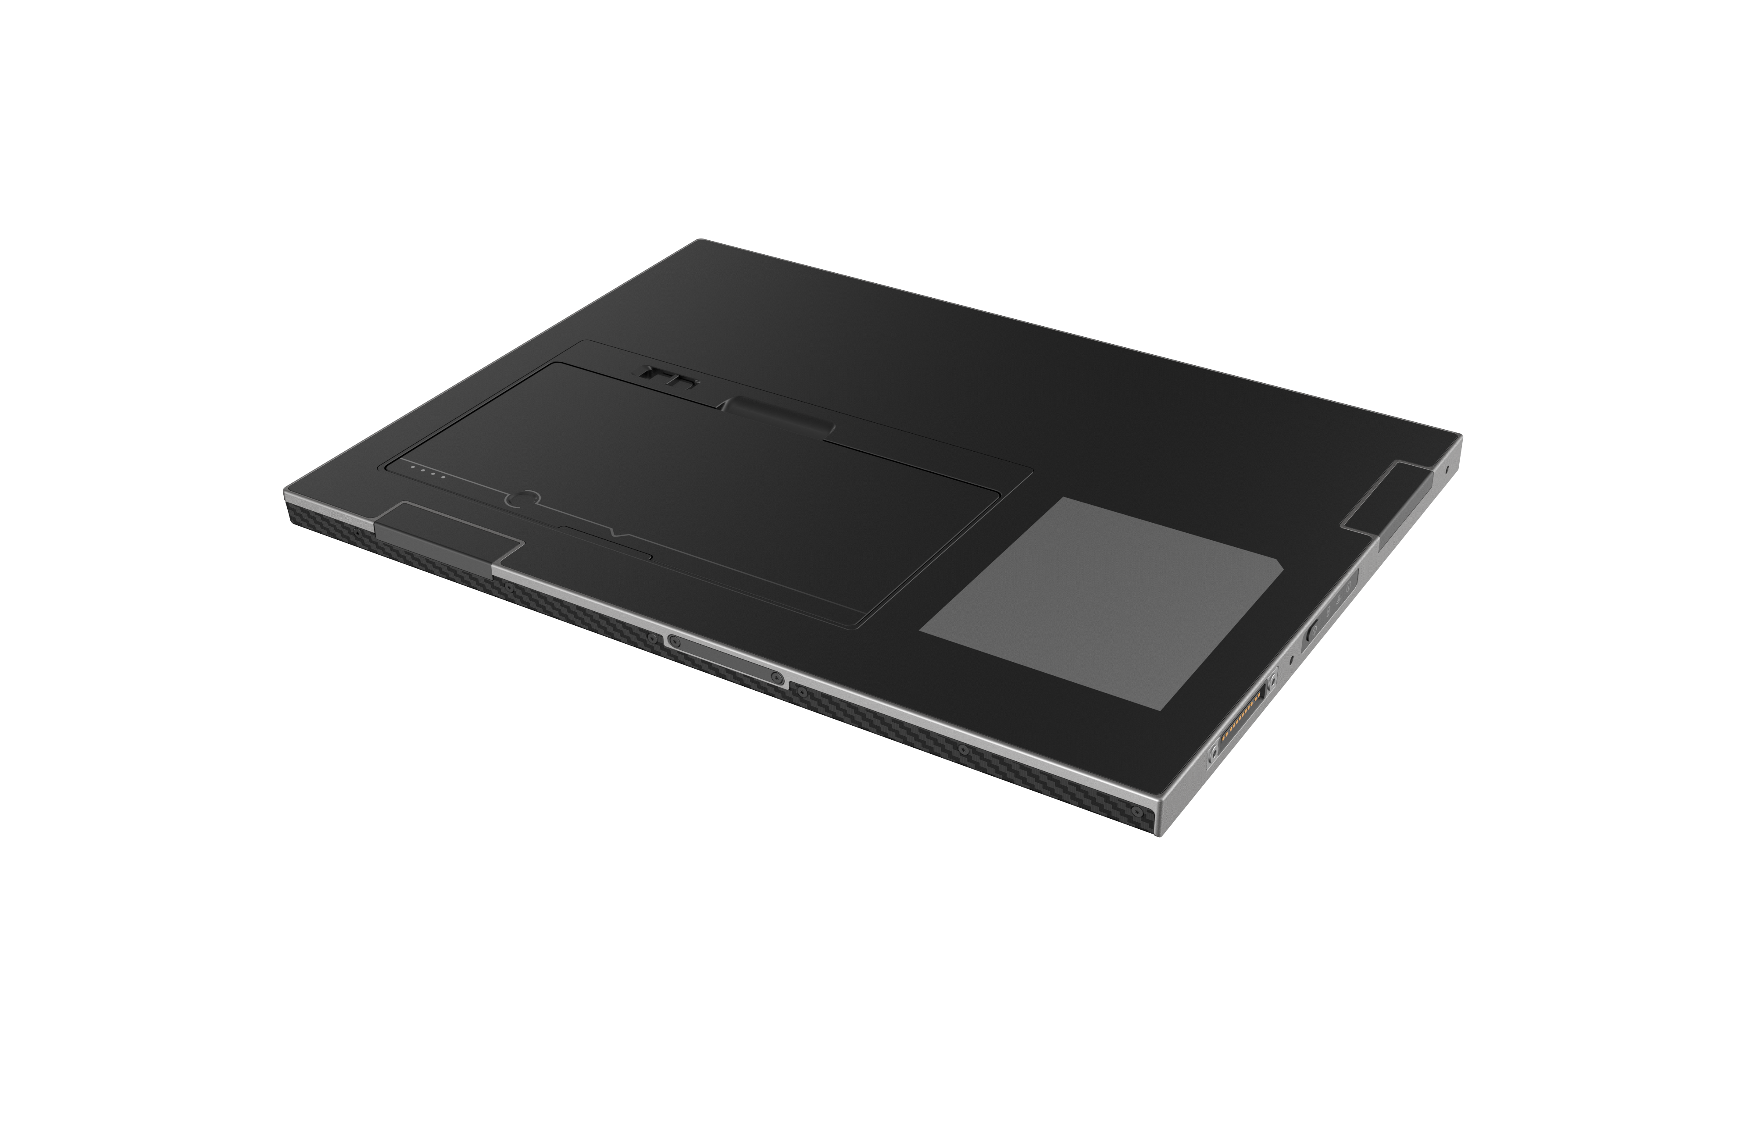

企业文化
X RAY SYSTEM CORE TECHNOLOGY
Core Part Ⅱ
Digital flat-panel detector
iRay Technology is the biggest brand of flat panel detectors in China. Its X-ray FPD have excellent cost performance and have reached the world's leading level in terms of image performance, quality stability and reliability, and are exported to more than 70 countries and regions in Asia, America and Europe, with currently global market share of 12.91%, ranking third in the world.

Slide 9
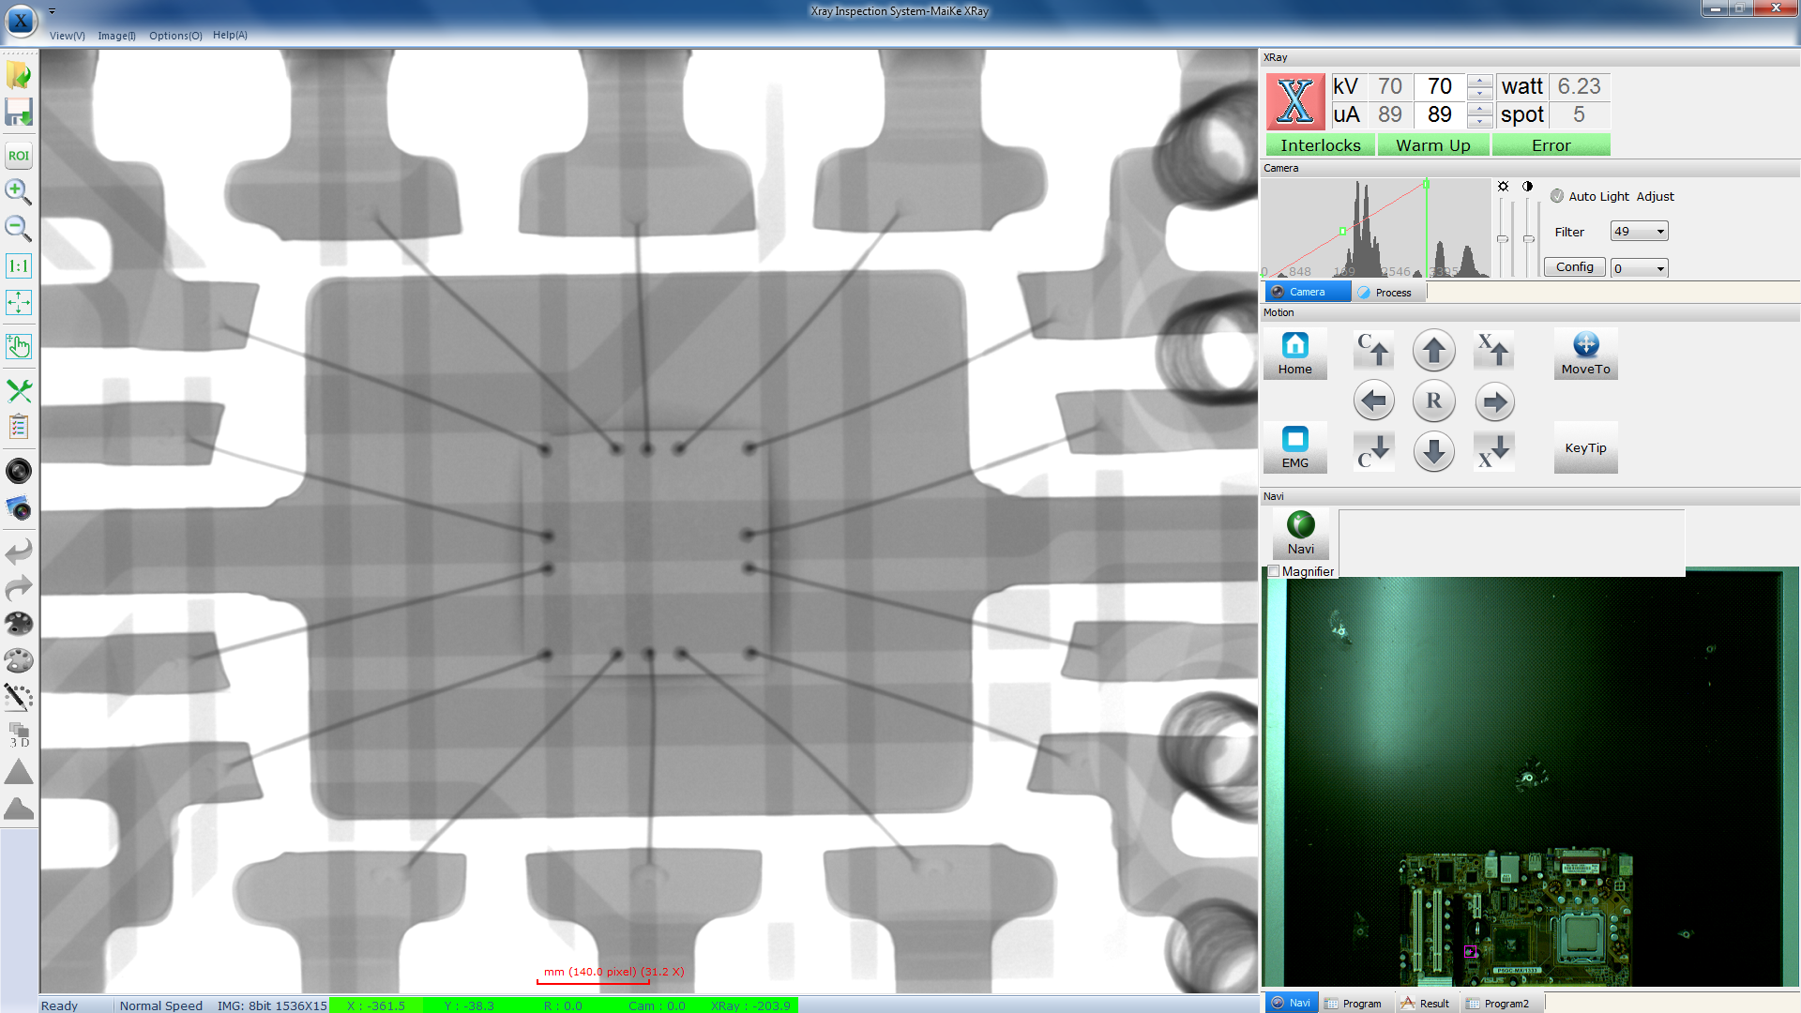
公司介绍
X RAY SYSTEM CORE TECHNOLOGY
Core Software Ⅲ
Good performance X-ray software
Our powerful software is designed by independent R&D to use friendly for faster visualization and inspection. It produces the most realistic and vivd X-ray images available today.That’s due to its unique ability to focus on inspection area and achieve clear visual fault detection with less artifacts.The powerful software enables optimized automated X-ray and 2.5D industrial quality inspections,delivering even more accurate results.
The software also configures valuable multiple measurement toolbars:distance,distance ratio, line spacing,angle,arrow mark,circle radius,point distance,center distance, circumference, hand-drawn polygon, hand- drawn free-form,add text description,area,roundness,total bubble ratio,maximum bubble ratio,width,height,gray scale,movement and so on.

Slide 10
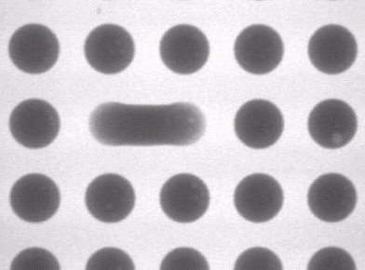


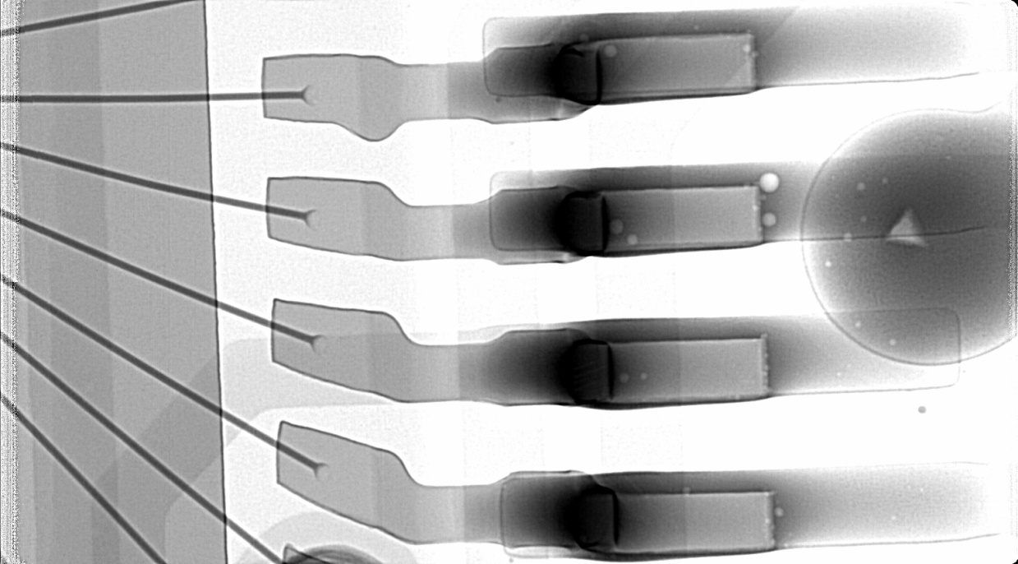
X RAY SYSTEM DEFECTS IMAGES
welding voids
welding voids
welding voids
welding voids
short circuit ball
short circuit ball
BGA bubbles
BGA bubbles
BGA tilting 2.5D
ball deformed
BGA bubbles
QFN X-ray image

Slide 11
X RAY SYSTEM PARAMETER
specs | iterms | substance | contents
Technical spes | System summary | machine dimension | 1400×1300×1700 mm
 |  | machine weight | 1300 kg
 |  | power supply | AC 110~220V 50/60 Hz
 |  | packing dimension | 1700×1600×2000 mm
 |  | packing weight | 1200 kg
 |  | power consumption | 1.2 kw
 | X-ray tube | tube type | sealed tube
 |  | voltage/current | 0~90Kv ( optional ) / 0~200 uA
 |  | max.power | 100 W
 |  | focus spot size | 3~5 μm
 | Imaging system | detector type | digital flat-panel detector
 |  | pixel size | 85 μm
 |  | inspection area | 13×13 cm
 |  | pixel matrix | 1536×1536
 |  | detection speed | 40 fps
 |  | magnification | 1600x
 | Safety system | radiation leakage | ＜0.3 μSv/h ( meets all international standards )
 |  | safety operation | electromagnetic interlock,safe window,warming light,emergency stop,X-ray switch linkage,etc.
 |  | lead protection | 22mm thickness anti-radiation glass and 6mm thickness shell

Slide 12
X RAY SYSTEM PARAMETER
specs | iterms | substance | contents
Technical spes | Process software | auto-measuring | BGA soldering voids auto-measuring/short circuit/cold soldering/crack/foreign materials,etc.
 |  | measuring tools | support measuring distance/angle/diameter/polygon/curve,etc.
 |  | CNC mode | CNC programmable inspection/easy operation and mass inspection
 |  | area measuring | preset area standard and NG auto-warming
 |  | auto-navigation | convenient target point positioning system
 |  | 3D model | BGA and other components 3D model
 | Motion system | movement control | joystick,keyboard,mouse
 |  | max.platform area | 700×700 mm
 |  | max.loading area | 570×570 mm
 |  | max.loading weight | ≤ 15 kg
 |  | max.inspect area | 550×550 mm
 |  | oblique views | detector 0~65°
 |  | manipulator | 5-axis with X/Y/Z1/Z2/T1
 | Industrial PC | monitor | 24 inches
 |  | system OS | windows 7
 |  | hard disk | 1000 GB
 |  | RAM | 4 GB
 |  | CPU | I5
 |  | working temp | 0~50 ℃

